Slide 1

Q&A with C#
#3: Collections
#4: Dependency Inversion Principle (SOLID)

Slide 2

Collections in C#

Slide 3


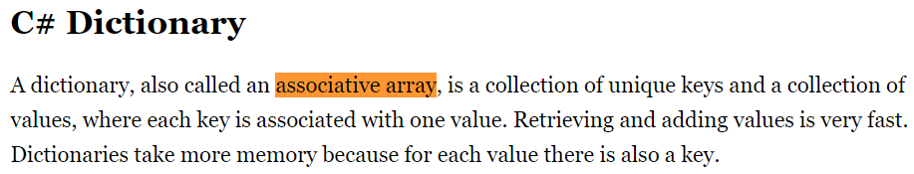
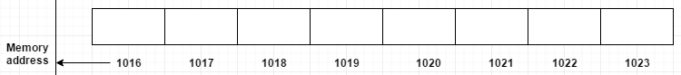
Everything is… array

Slide 4

Collections are grouped (in namespaces)
9 collections
Array
+1
10 collections
Doesn’t need any namespace
7 collections
16 collections
5 collections
https://docs.microsoft.com/en-us/dotnet/api/?view=net-6.0

Slide 5
Why do we have so many collections?
1. To achieve the specialization => the purpose of the collection
2. To control the performance => consequence of specialization
3. To support the legacy code (backward compatibility)

Slide 6
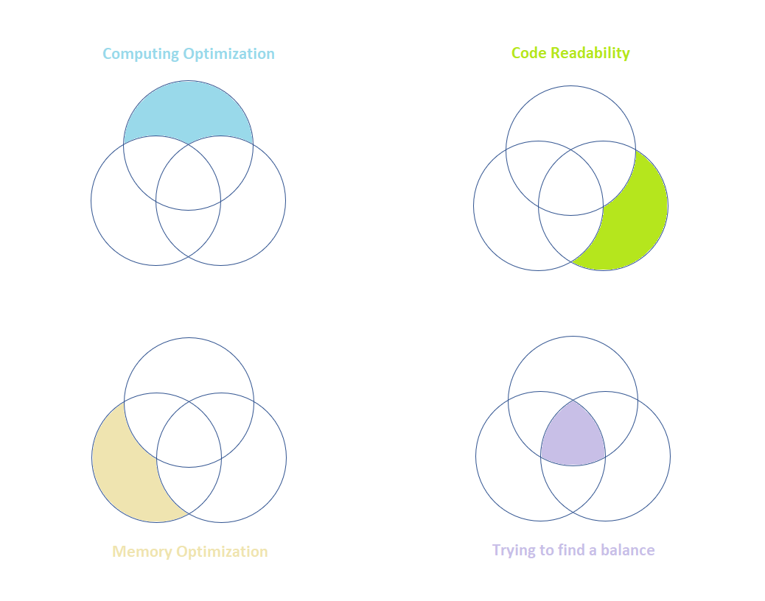
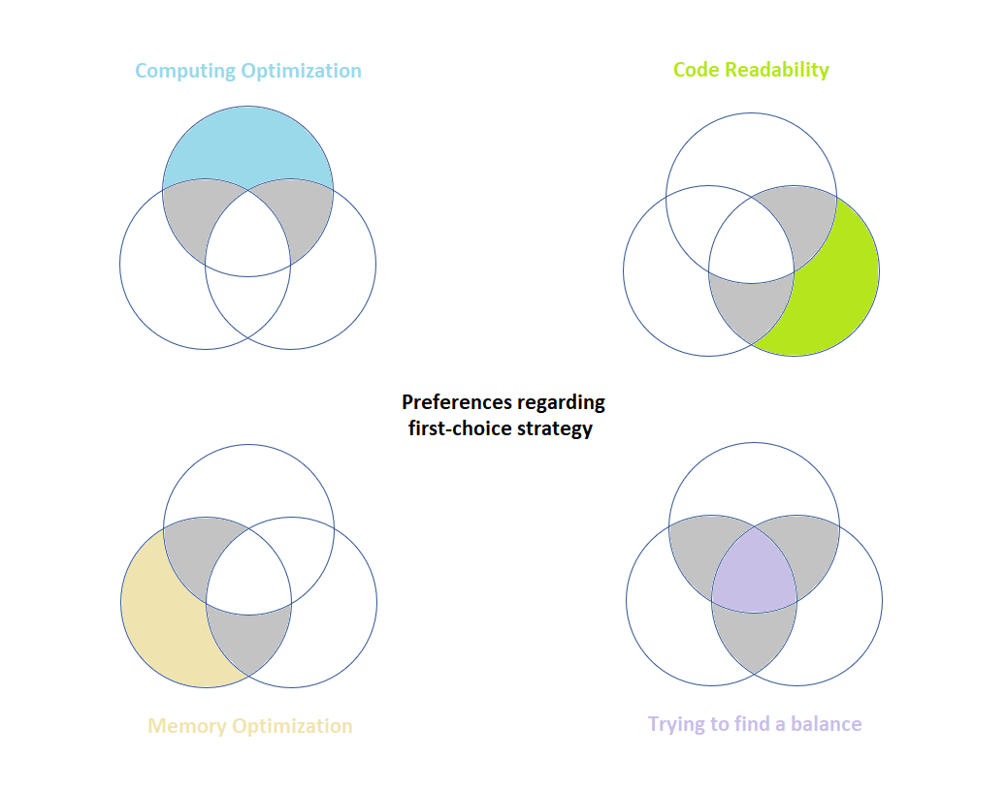
Different priorities in software
Realistically saying, this is impossible

Slide 7
Which collection is “the best”?
https://docs.microsoft.com/en-us/archive/blogs/ericlippert/arrays-considered-somewhat-harmful (arrays are usually not the best option for you. In 95% cases prefer Lists)
https://stackoverflow.com/questions/454916/performance-of-arrays-vs-lists/42753399 (but in other hand… arrays are significantly faster than Lists, good for code optimizations*)
https://stackoverflow.com/questions/3628425/ienumerable-vs-list-what-to-use-how-do-they-work (when already using Lists, remember that they are heavier than their predecessor IEnumerable)
https://medium.com/@ben.k.muller/c-ienumerable-vs-list-and-array-9f099f157f4f https://www.claudiobernasconi.ch/2013/07/22/when-to-use-ienumerable-icollection-ilist-and-list/ (Which one should you use then? To answer that, ask yourself: “what do you want to achieve”)
https://stackoverflow.com/questions/995766/comparison-of-collection-datatypes-in-c-sharp (and to answer this question, consider very useful comparison of performances and specializations)

Slide 8
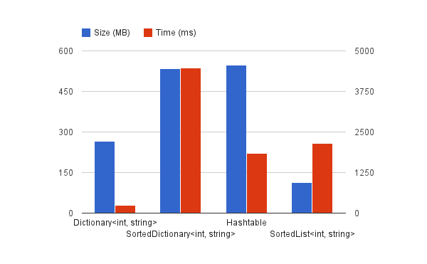
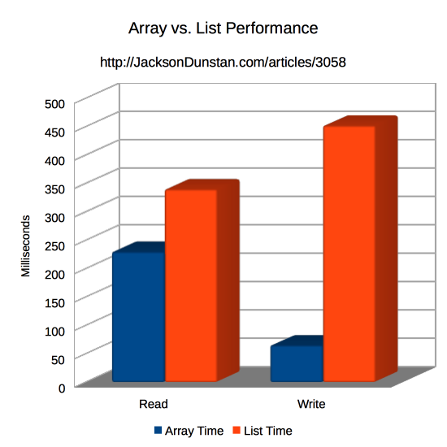
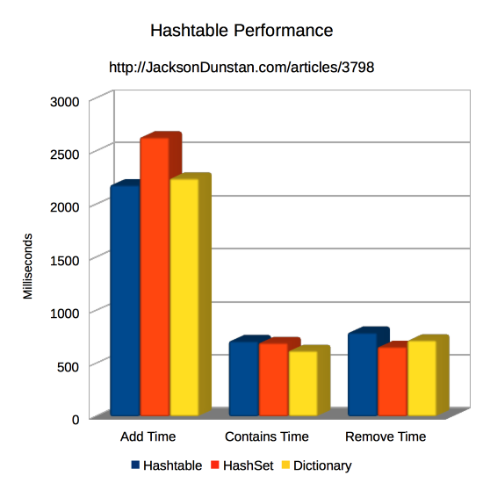
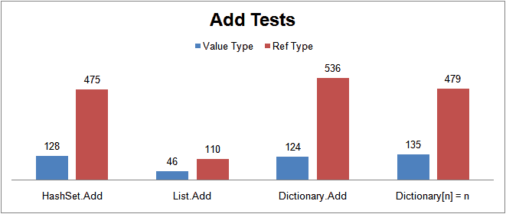
Performances
Very slow
Very heavy
Array is readonly, that’s why it is already prepared / optimized for read and write operations (it has fixed, immutable size)
All key-value based collections are smart, using shortcut features (sorting, unique) but they are super heavy and super slow
Heavy
List is the best option for dynamic collections, because it is the fastest to add items into
9x slower
3-4x slower
3-5x slower
3-4x slower

Slide 9
Specializations
Specialized collections can be used to spare repetitive code to be written
Array – fixed size, the fastest to iterate over it (strong for preference over foreach loop) very fast to access specific item using its index, very expensive to change its size
Iteration
Index
List – the most universal one, reasonable fast to add and remove an item, dynamic
Manipulation
Relationship between items
Head / Tail
LinkedList – very fast to add, remove, or access first or last item. Items are connected
Like graphs
Dictionary – very fast to access specific item using its key. Combined information
Unique
Pair<Key, Value>
Stack – used only for algorithmic purposes to get LIFO behavior
Order of processing
Queue – used only for algorithmic purposes to get FIFO behavior
Order of processing
HashSet – to store unique values and not implement this behavior on your own
Unique
Validated
lists, sets, dictionaries
Sorted… – to keep sorted values by key and not implement this behavior on your own
Sorted
lists, sets, dictionaries
Immutable… – to preserve the same state of data structure (light, readonly collections)
Immutable
lists, sets, dictionaries
Concurrent… – to work safely with multiple threads and not implement locks on your own
Thread-safe

Slide 10
Generic vs non-Generic
NOTE: We are not using not generics collections anymore in modern programming languages
non-Generic (list)
Generic (list)
ArrayList
List<T>
add
get
add
get
boxing
type is defined
int: 10
(int)
object: 10
int: 10
int: 10
casting
int: 10
non-Generic collections are “detached” from their items type; not aware about them

Slide 11
Inheritance map (generic <T> collections)
Object
GetEnumerator()
IEnumerable
Count
IReadOnlyCollection
Count
Add()
Remove()
Used for LINQ purposes with query providers
Some collections also inherits from this one
ICollection
IQueryable
CopyTo()
Clear()
IsReadonly
Contains()
Queue
Stack
LinkedList
IntersectWith()
SymmetricExceptWith()
IndexOf()
[index]
Keys
Values
ExceptWith()
IsSubsetOf()
SetEquals()
IList
[Key]
IDictionary
Add(K,V)
UnionWith()
ISet
IsSupersetOf()
Insert()
RemoveAt()
TryGetValue()
ContainsKey()
Overlaps()
IsProperSupersetOf()
List
Dictionary
SortedList
HashSet
SortedSet
SortedDictionary

Slide 12
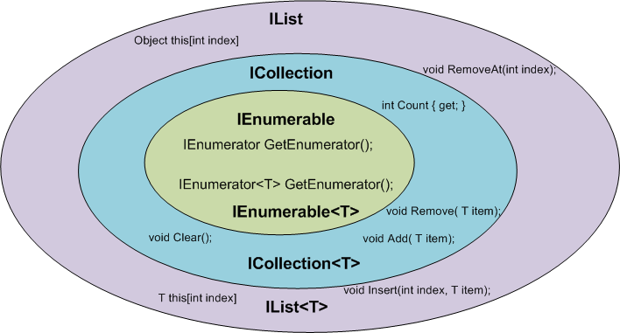
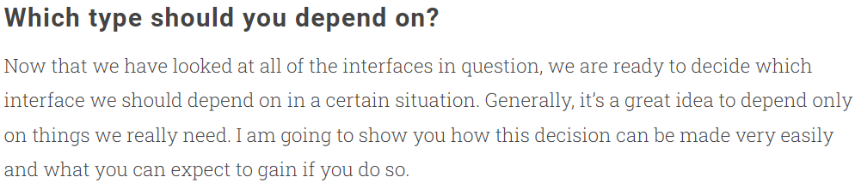
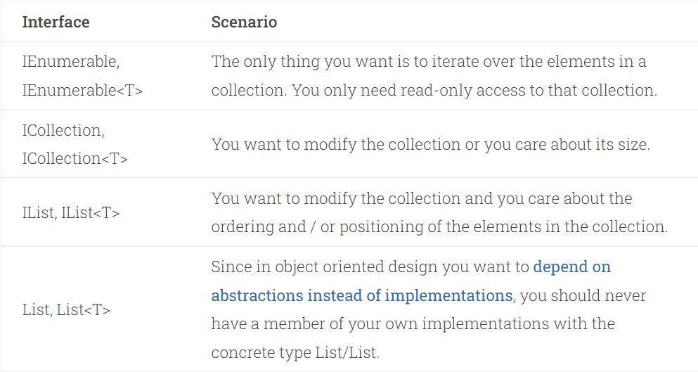
Using proper interface (basic)

Slide 13
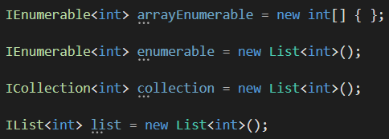
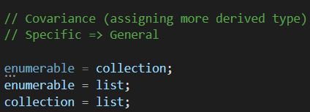
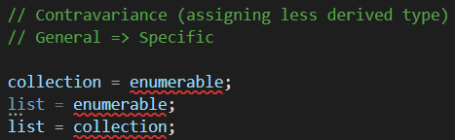
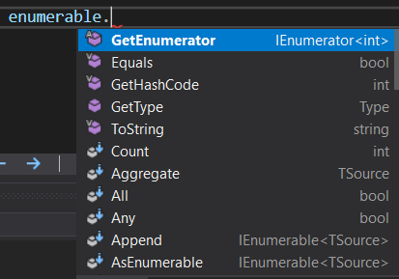
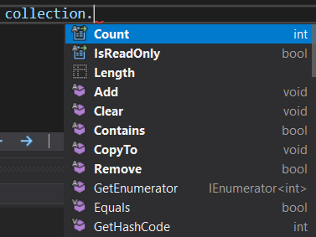
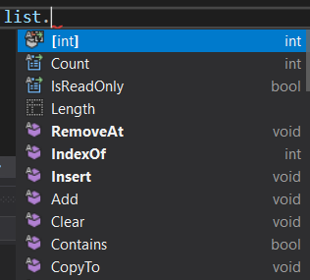
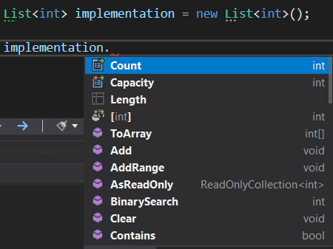
Example of deriving behaviors

Slide 14
Returning interface or implementation?
Non-Private logic:
Private logic:
prefer interface
prefer implementation
- In OOP flexibility is the key (e.g., generics, polymorphism)
- Private logic and members are usually specialized (by intention)
Dependency Inversion Principle
- This is also a place to made some micro-optimization to boost up the performance
Liskov Substitution Principle
NOTE: Interfaces are slightly slower
„You do not know who and how is going to use your code”
“The code is designed to not be accessible from outside”

Slide 15




Order of preference
interface
abstract class (parent)
class (parent)
class (child)

Slide 16
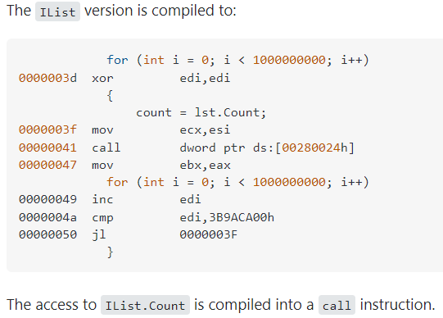
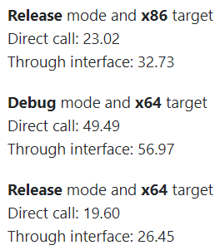
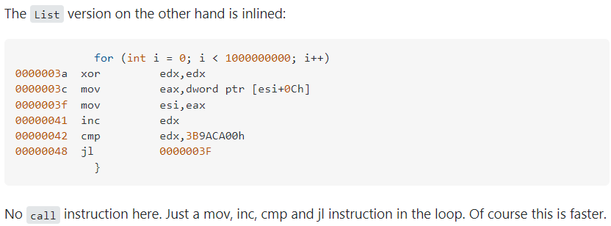
Why interfaces are slower?
- .NET CLR needs to resolve the type to match the concrete implementations with the contracted behaviors
- In IL code runtime logic will be called on demand, not a property
IL code:
We are using interfaces for flexibility.

Slide 17
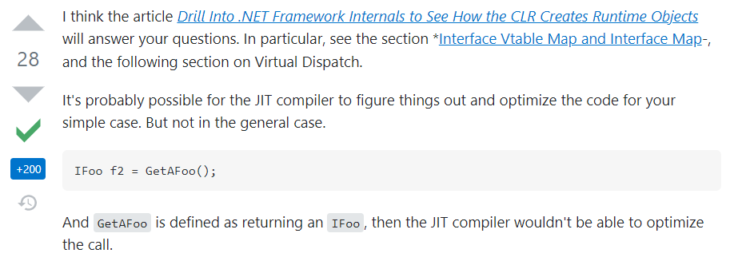
Technical explanation:

Slide 18
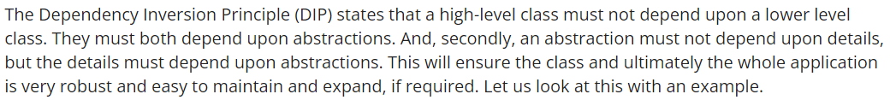
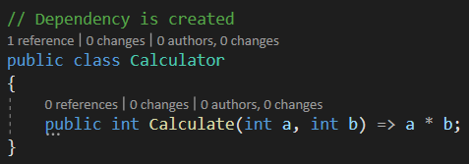
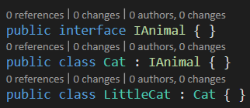

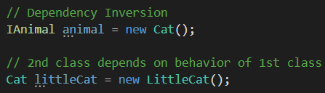

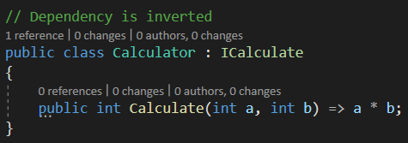
Dependency Inversion Principle

